Slide 1
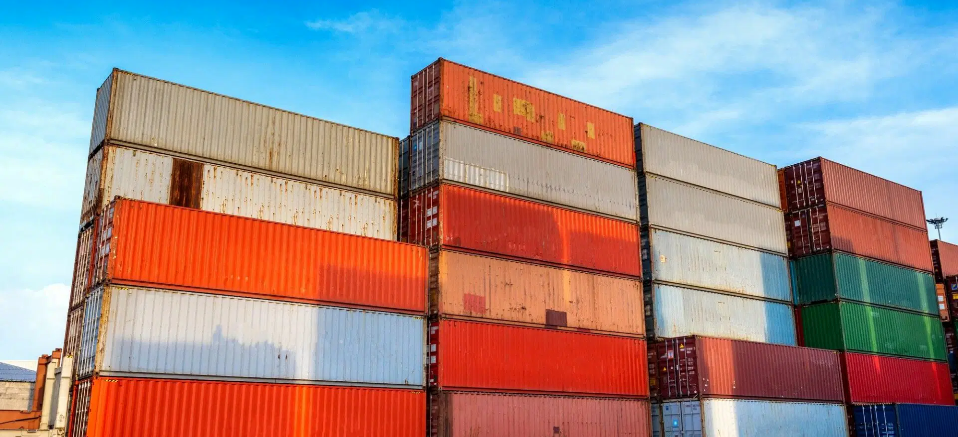
PRODUCT CATALOGUE 2024
PT. FAZZA INDO OMAIRA
www.fazz-indo-omaira.com
Notes:
https://www.freepik.com/free-photo/stylish-living-room-daylight_2070548.htm#page=3&query=furniture&position=26

Slide 2
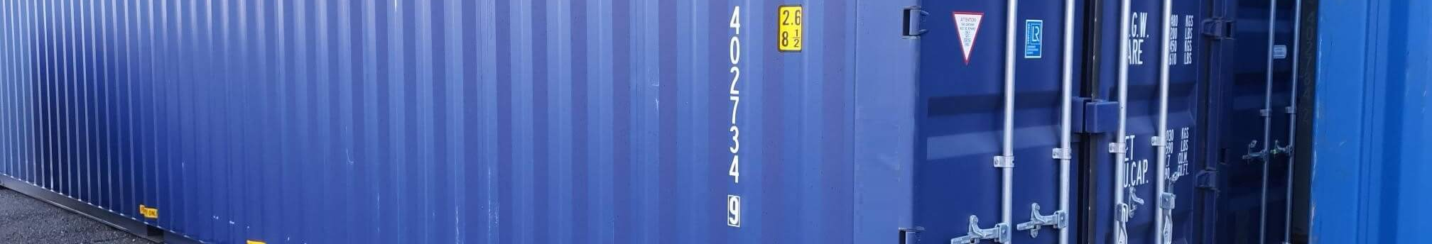

01
About Us
ABOUT US
We are delighted to introduce our company named PT. FAZZA INDO OMAIRA. We specialize in exporting premium commodities within our region. Given the abundant natural resources in our area, our primary goal is to introduce the commodities from our region to the global market. Hence, we established this company in 2023.
Although we are new to the export sector and have not yet undertaken prominent projects in this industry, we believe that our products or services offer significant value to meet your needs. We are committed to providing quality solutions and excellent service, and we are ready to work hard to build a solid reputation between both parties.

Slide 3
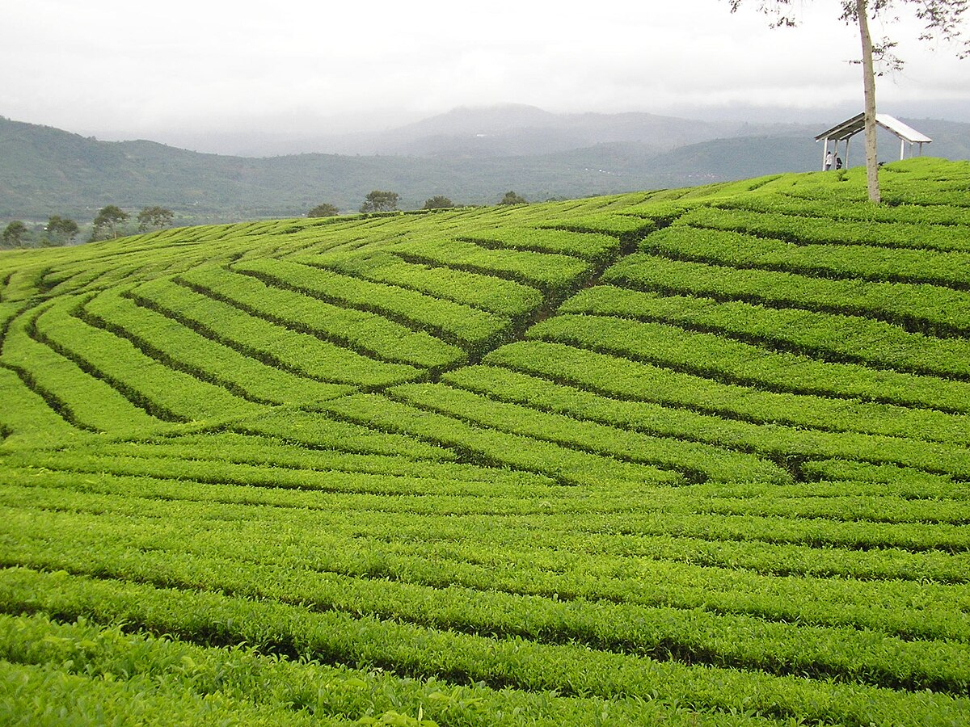
02
MOUNT DEMPO UNTRODUCTION
Mount Dempo tea production is carried out with in-depth expertise and using the latest manufacturing equipment, including sophisticated Tea processing machines and strictly controlled drying techniques. We ensure that our raw materials come from well-maintained tea gardens around mount Dempo, and our supply base is quality assured to produce high-quality Tea that meets international standards.

Slide 4
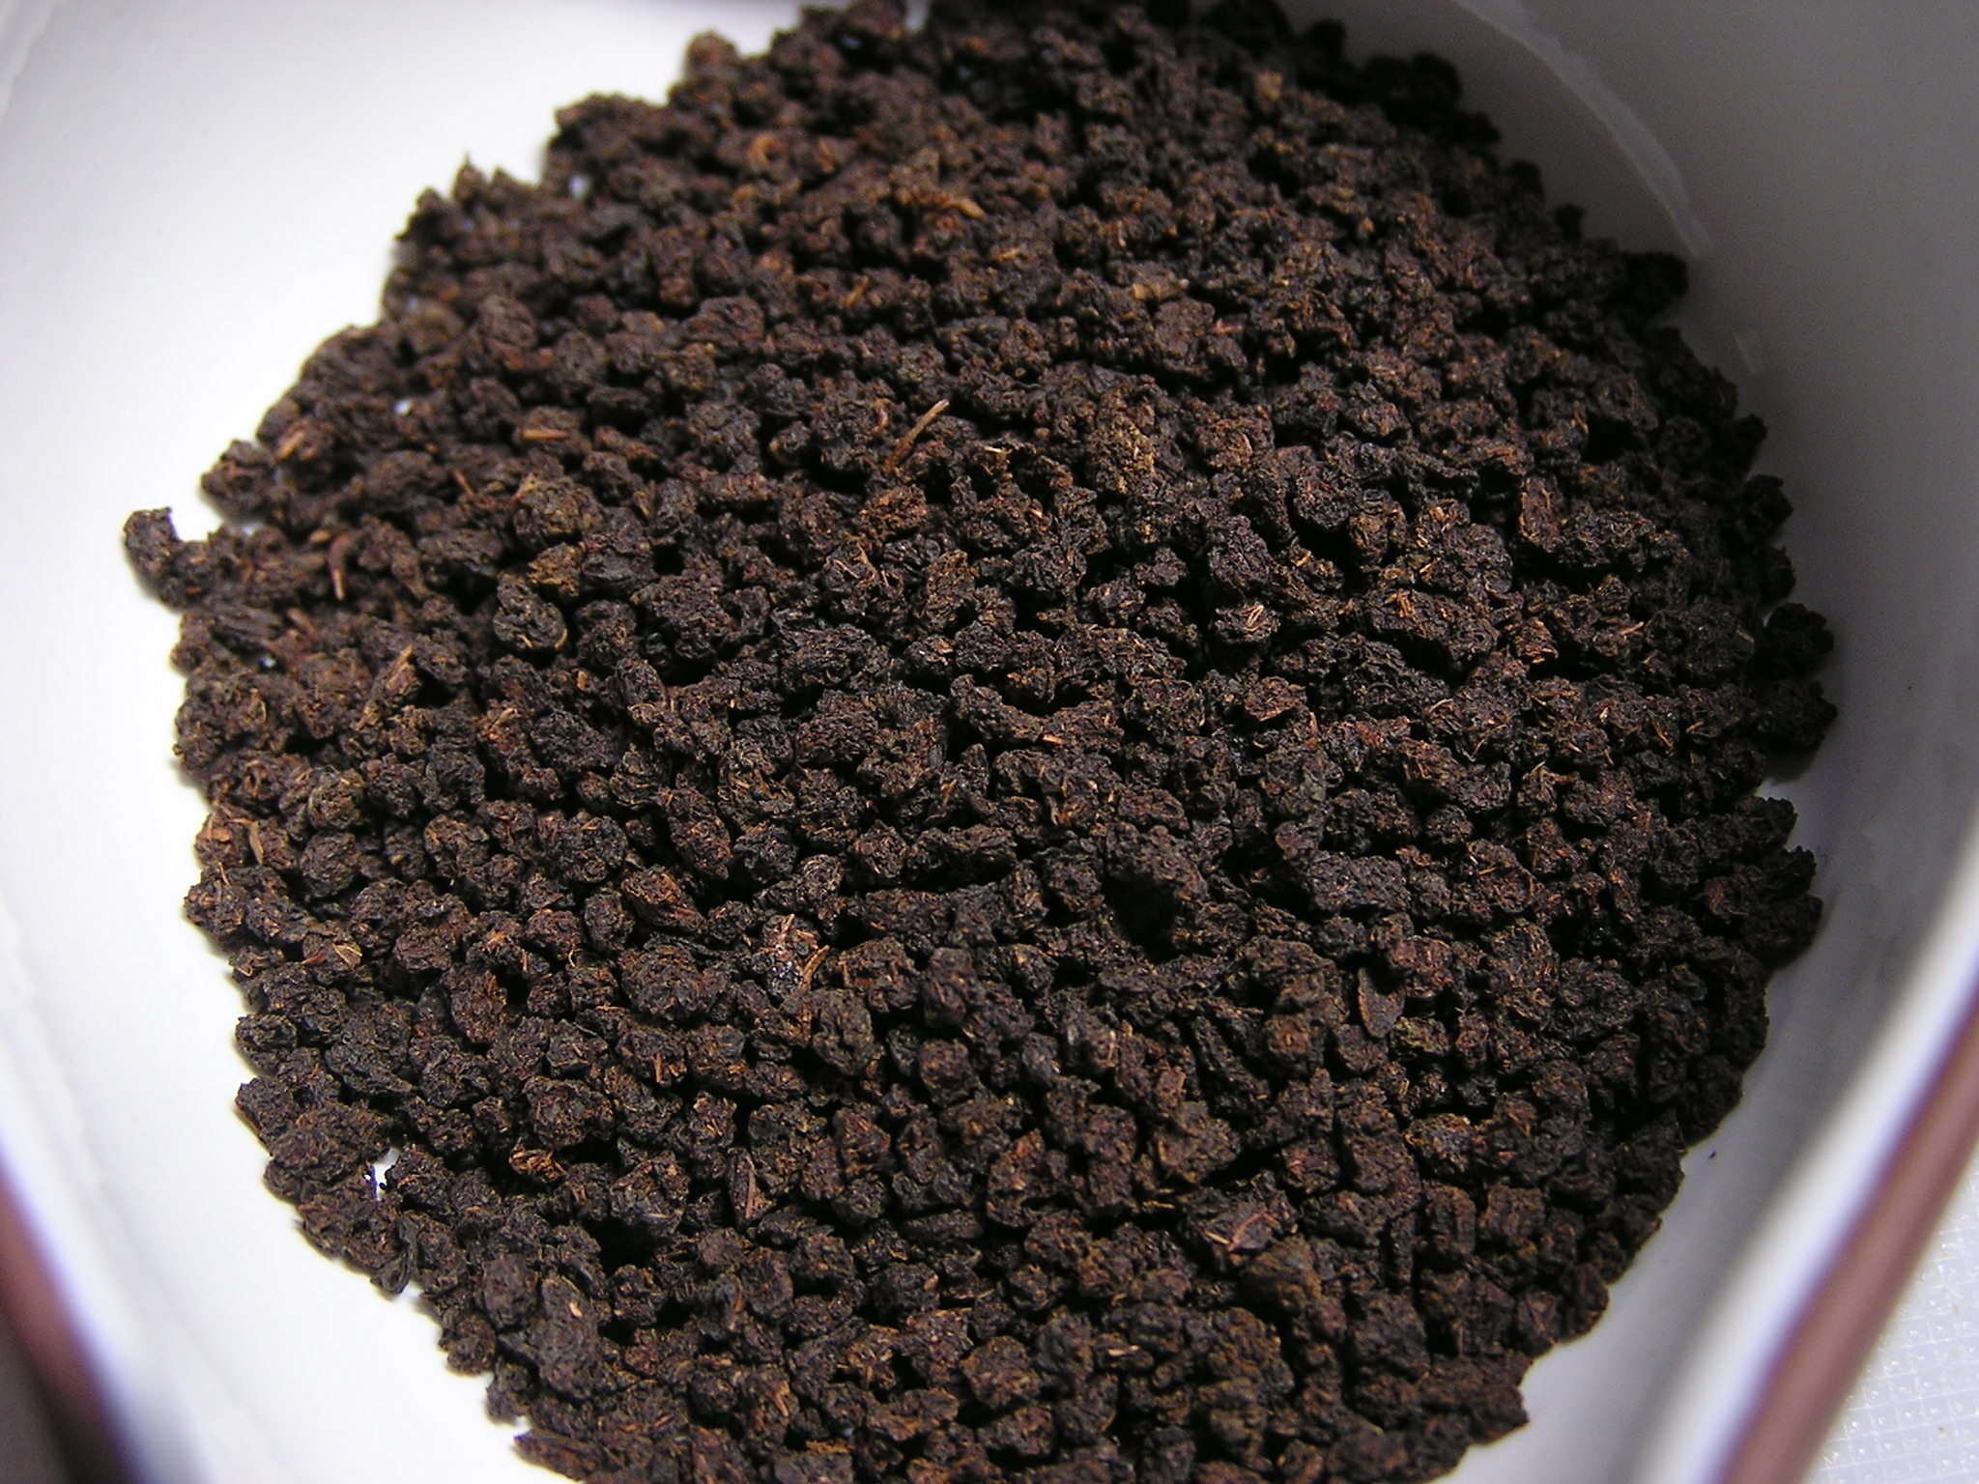

03
Our Categories
OUR CATEGORIES
LOCAL PLANTS
Indulge in the rich flavors of our local treasures: coffee and tea, esteemed worldwide for their unparalleled quality and distinctive taste. ☕🍃 #WorldClassFlavors #LocalPride

Slide 5
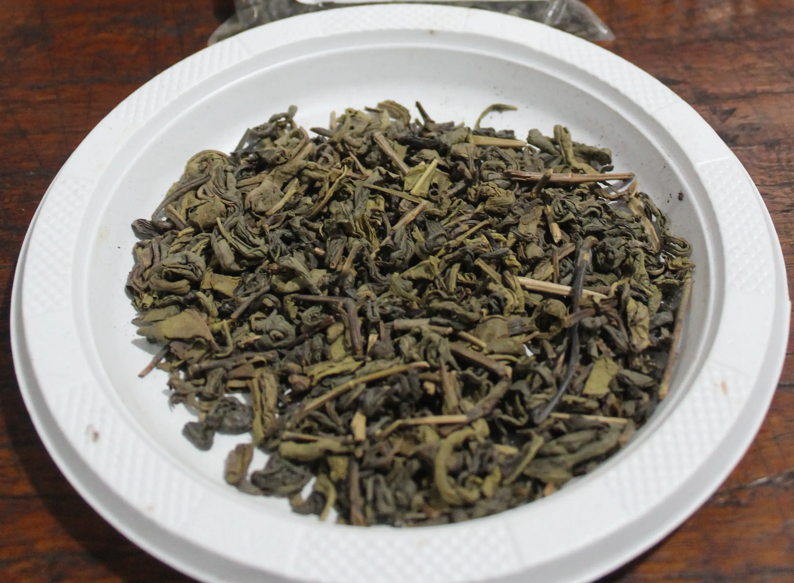
04
Product List
CTC BLACK TEA
GREEN TEA
PRODUCT LIST
Unwind and savor the exquisite taste of CTC Black Tea.
Discover the serene essence of Pagaralam's Green Tea.
Explore our curated collection, where every item is a testament to quality, creativity, and authenticity. Welcome to a world of possibilities. 🛍️✨ #DiscoverExcellence #ShopLocal

Slide 6
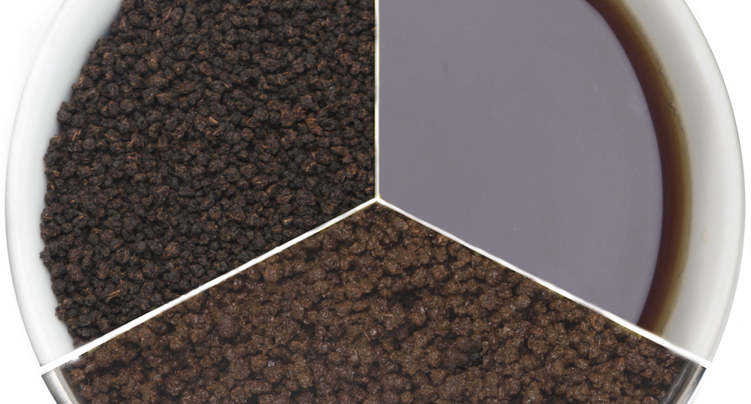
05
CTC BLACK TEA
CTC BLACK TEA
Unwind and savor the exquisite taste of CTC Black Tea, meticulously crafted to offer a symphony of robust flavors and captivating aroma. Whether you seek a moment of tranquility or a boost of energy, let each sip immerse you in pure delight. Embrace the timeless tradition of tea with CTC Black Tea, your perfect companion for every occasion. 🍵✨ #CTCBlackTea #TeaTimePerfection #SipAndEnjoy

Slide 7
06
CTC BLACK TEA PRICE LIST
CTC BLACK TEA STANDARD DENSITY
GRADE | CTC | PRICE
BP 1 | 300-330 | $6.05
PF 1 | 250-295 | $5.68
PD | 250-280 | $5.30
D 1 | 240-260 | $4.92
FANN | 290-310 | $4.56
D 2 | 235-245 | $4.18
FNGS | 295-320 | $3.84
BMC | 350-380 | $3.50

Slide 8
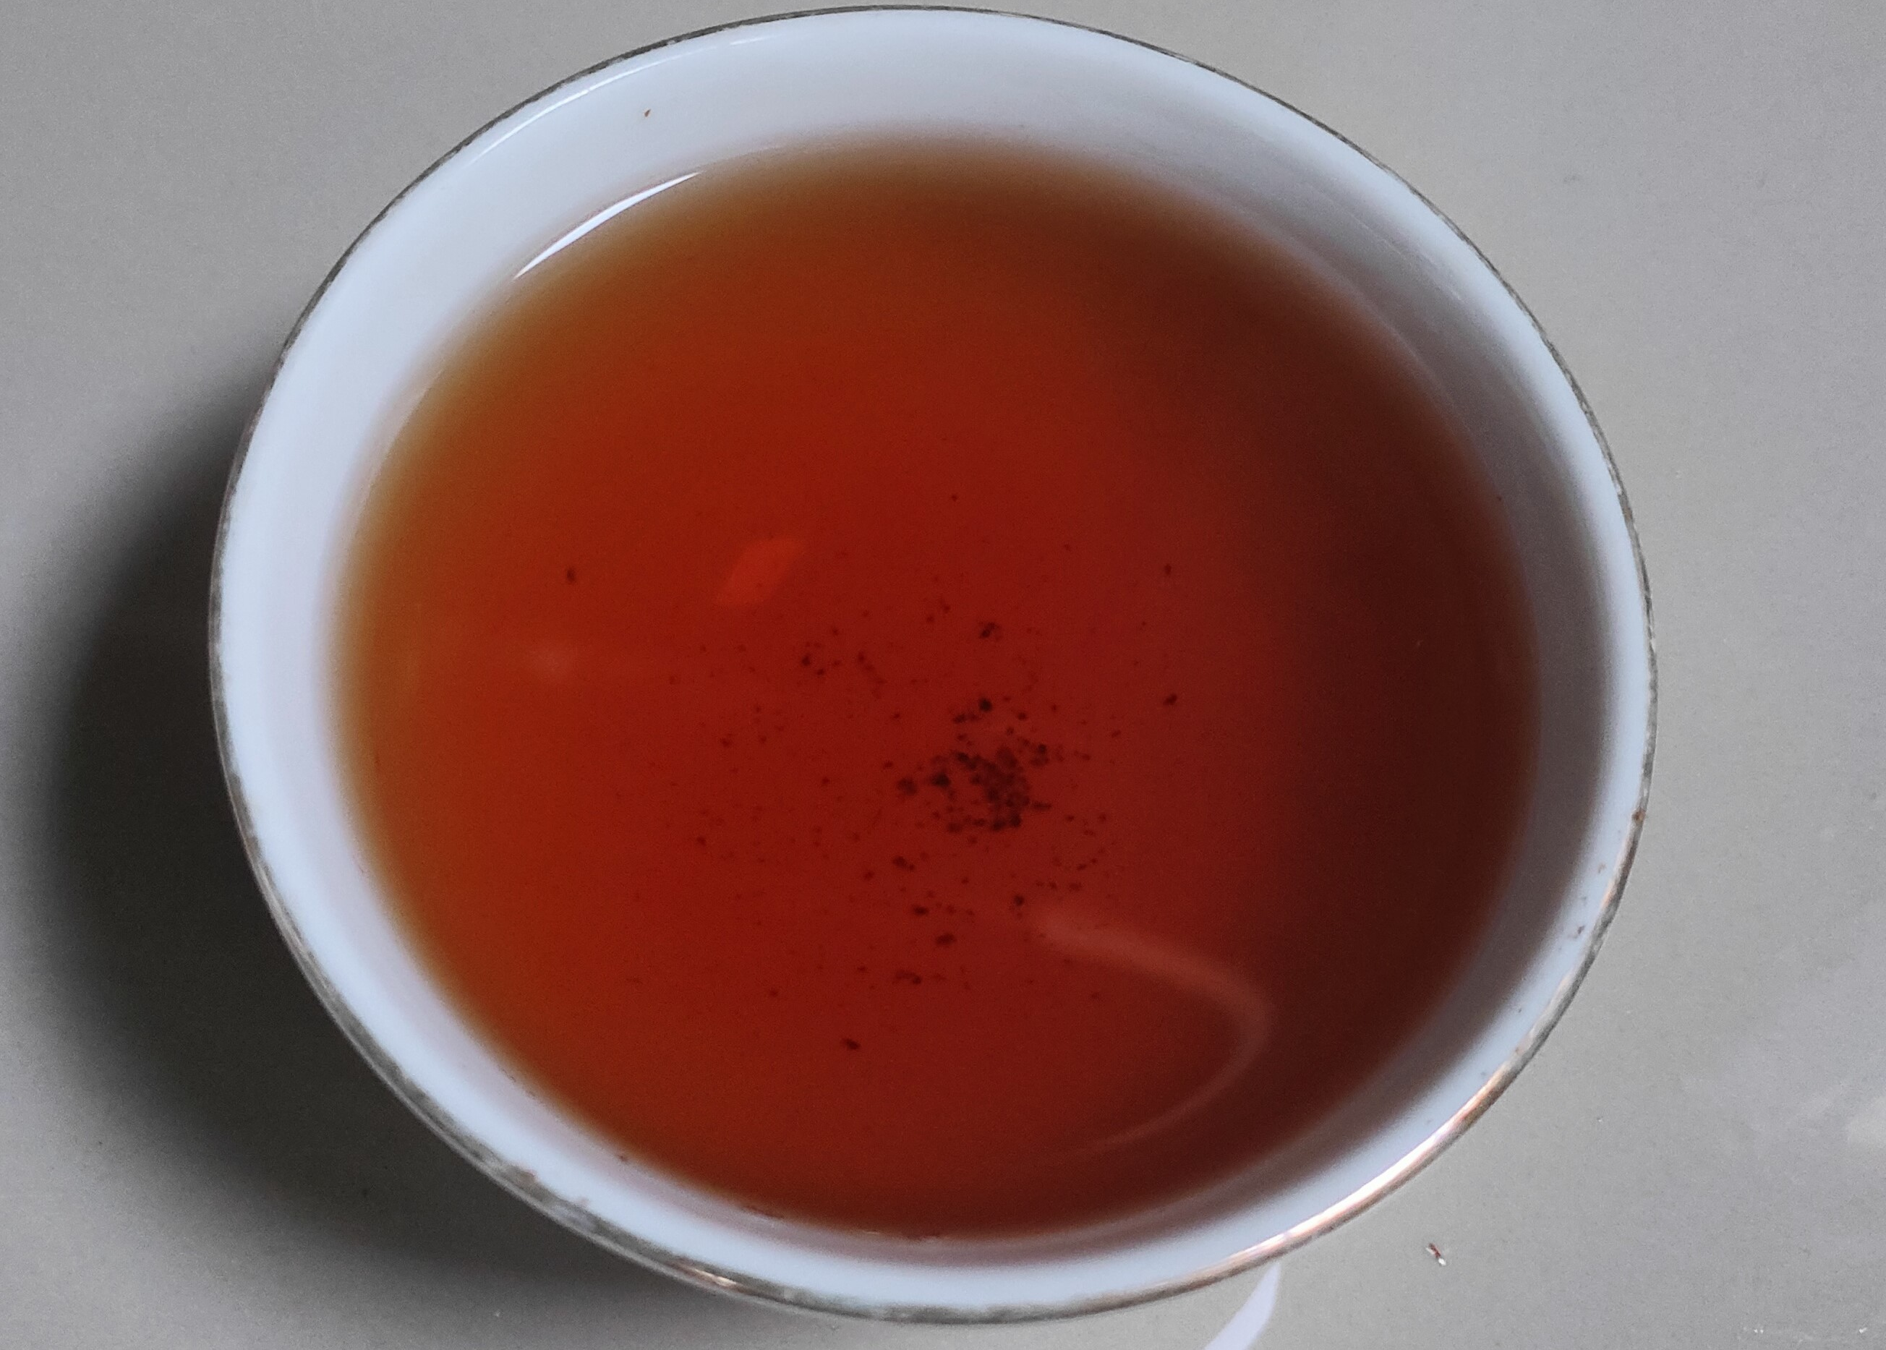
07
CTC BLACK TEA CHOP PACKAGING PER TYPE
CTC BLACK TEA CHOP PACKAGING PER TYPE
GRADE | SACK | KG | WEIGHT/SACK
BP1 | 20 | 1040 | 52
PF1 | 20 | 1100 | 55
PD | 20 | 1200 | 60
D1 | 20 | 1300 | 60
FANN | 20 | 1060 | 53
D2 | 20 | 1300 | 60
FNGS | 20 | 900 | 45
TEA WASTE | 40 | 1400 | 35

Slide 9
08
CTC BLACK TEA CHOP PACKAGING PER TYPE
CTC BLACK TEA PRICE
PRODUCT | GRADE | LOAD | FOB/KG | TOTAL
BP1 | GRADE 1 | 22.880 | $5.62 | $128.527
PF1 |  | 24.200 | $5.61 | $135.871
PD |  | 26.400 | $5.61 | $148.111
D1 |  | 26.400 | $5.61 | $148.111
FANN |  | 23.320 | $5.62 | $130.975
D2 | GRADE 2 | 26.400 | $4.91 | $129.751
FNGS |  | 19.800 | $4.93 | $97.620
BMC | GRADE 3 | 15.400 | $4.00 | $61.533

Slide 10
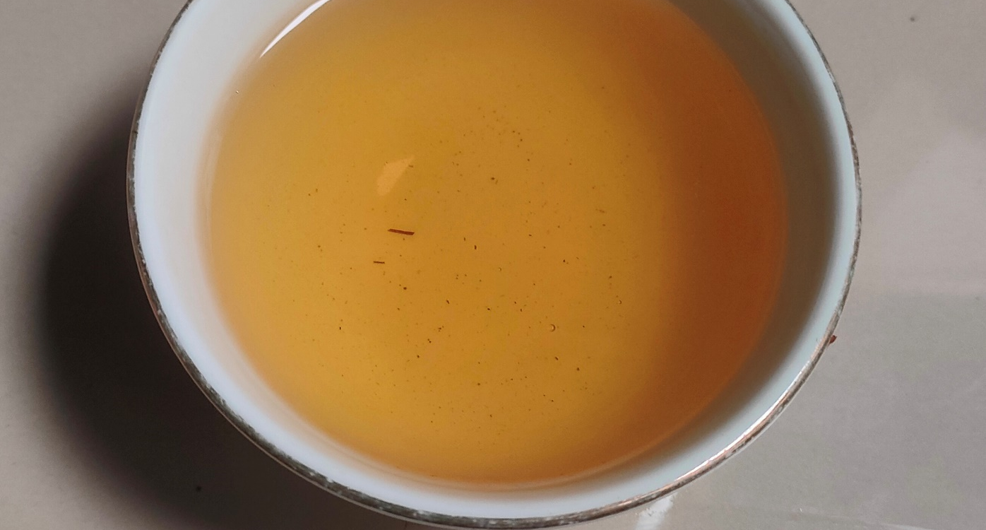
09
GREEN TEA
GREEN TEA
Discover the serene essence of Pagaralam's Green Tea, where each sip embodies the lush landscapes and crisp mountain air of this Indonesian gem. Elevate your tea experience with a taste of nature's tranquility. 🍃☕ #PagaralamGreenTea #SipOfSerendipity

Slide 11
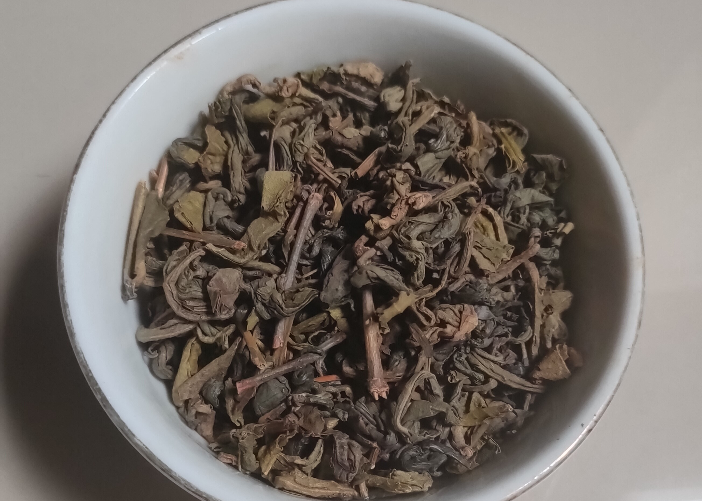
10
GREEN TEA COMPOSITION
GREEN TEA COMPOSITION
GRADE | COMPOSITION | KG | % | WEIGHT
KR 1 | FUNNEL 1 MIDLETONE | 160 | 20 | 40kg/sack
 | FUNNEL 2 MIDLETONE | 640 | 80
KR 2 | FUNNEL 1 MIDLETONE | 210 | 30 | 35kg/sack
 | FUNNEL 2 MIDLETONE | 420 | 60
 | FUNNEL 3 MIDLETONE | 70 | 10
KR 3 | BOLL TEA POWDER | 400 | 50 | 40kg/sack
 | PERFORATION | 128 | 16
 | SHIFTER POWDER | 80 | 10
 | MIDLETONE ROUGH FUNNEL | 128 | 16
 | DUST MIDLETONE | 64 | 8

Slide 12
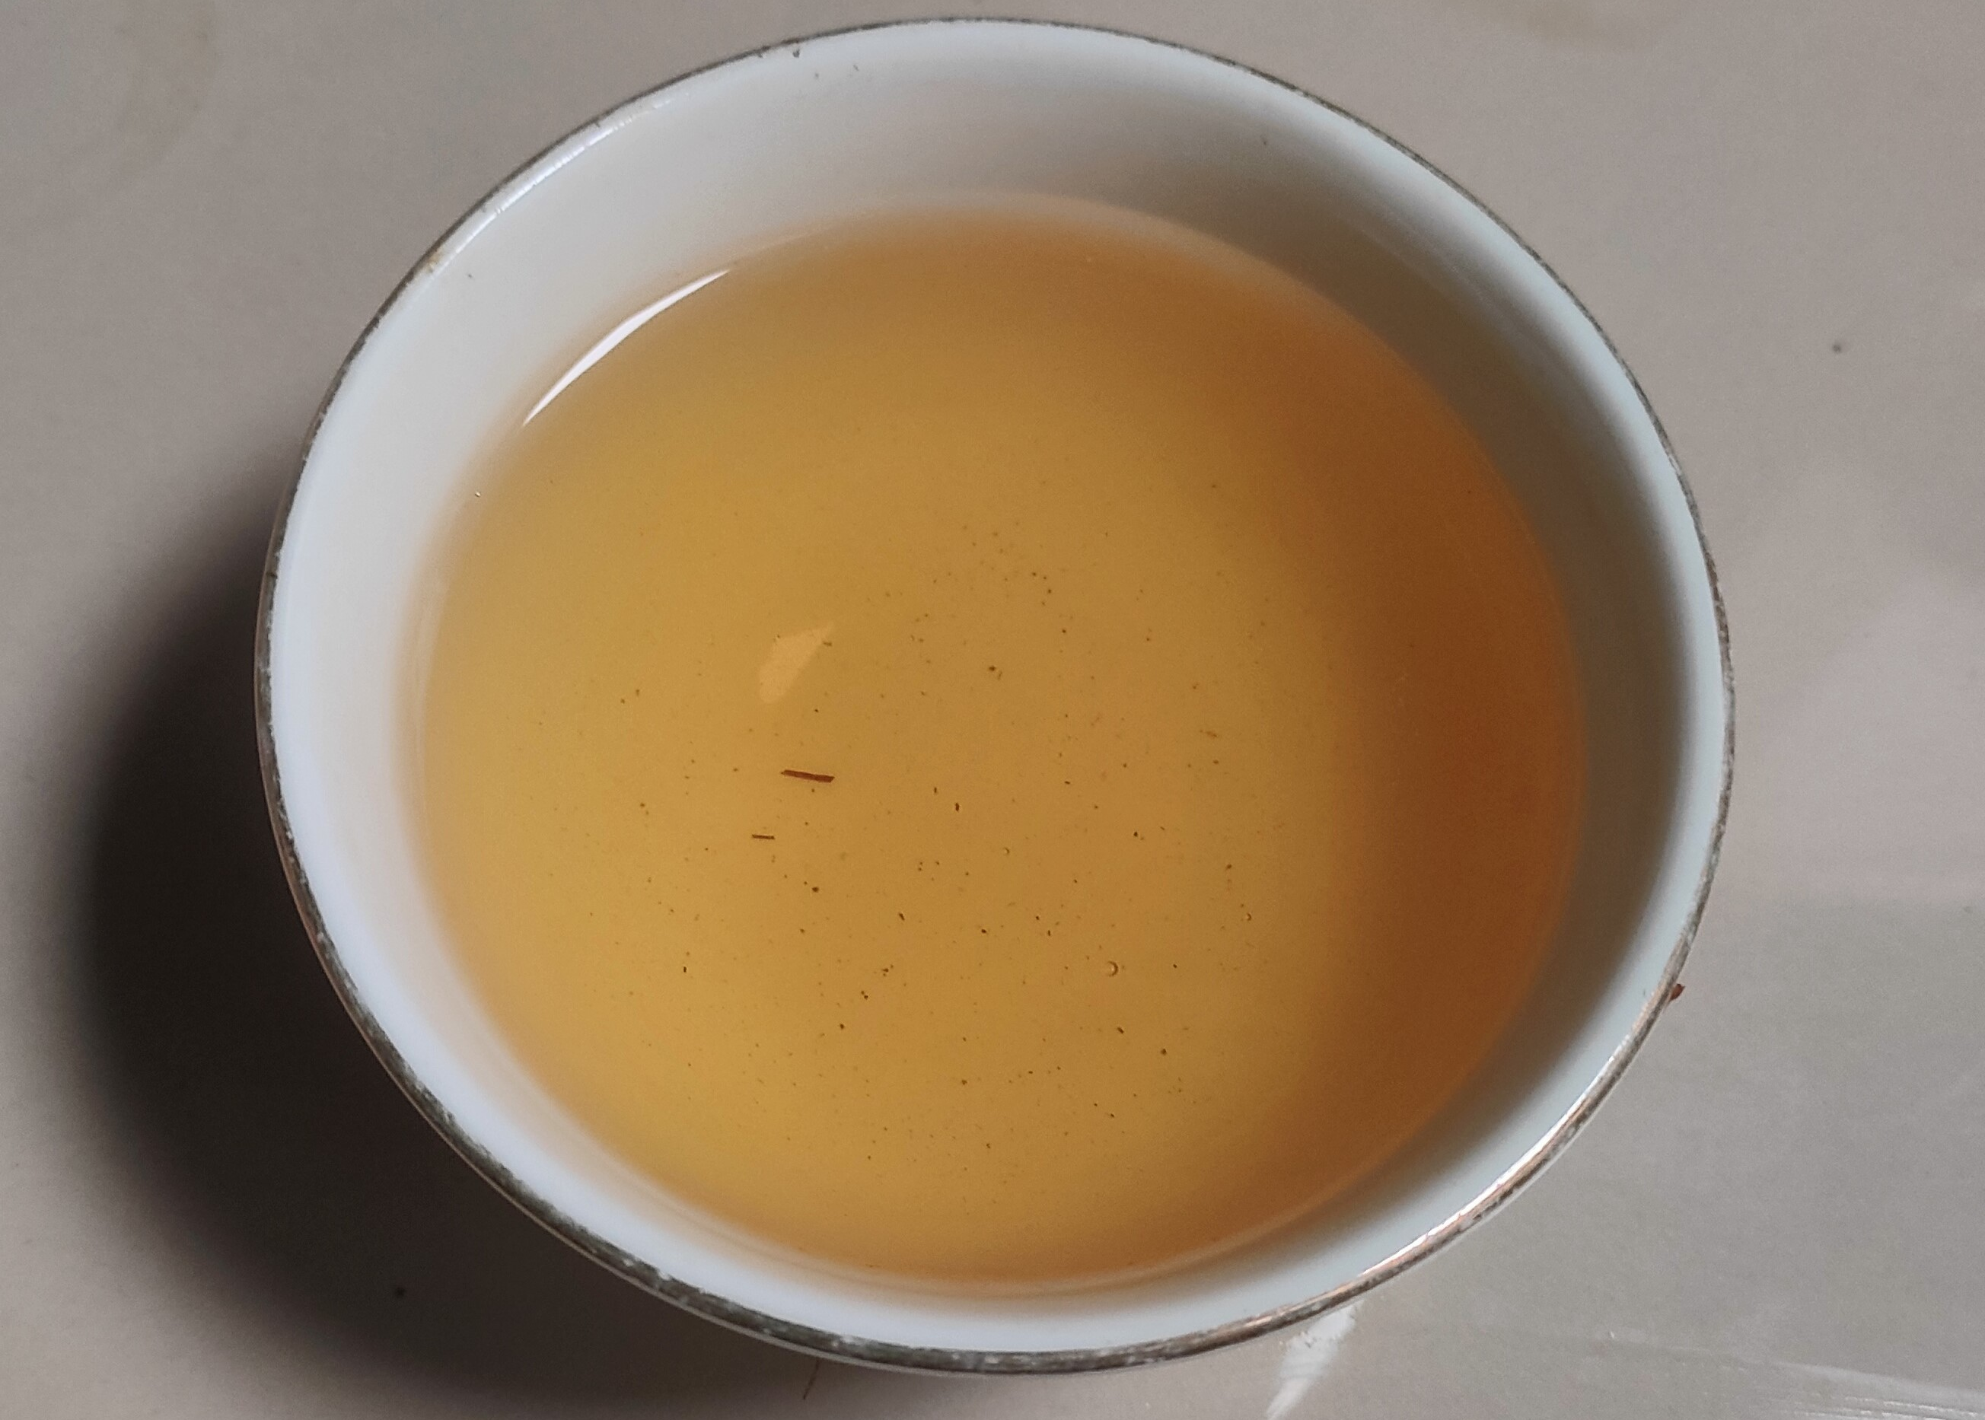
11
GREEN TEA CHOP PACKAGING PER TYPE
GREEN TEA CHOP PACKAGING PER TYPE
GRADE | SACK | KG | WEIGHT/SACK
KR1 | 40 | 800 | 20
KR2 | 35 | 700 | 20
KR3 | 40 | 800 | 20

Slide 13
12
GREEN TEA PRICE
GREEN TEA PRICE
PRODUCT | LOAD | FOB/KG | TOTAL
KR1 | 18.400 | $7.87 | $144.735
KR2 | 16.100 | $7.87 | $126.643
KR3 | 18.400 | $7.87 | $144.735

Slide 14

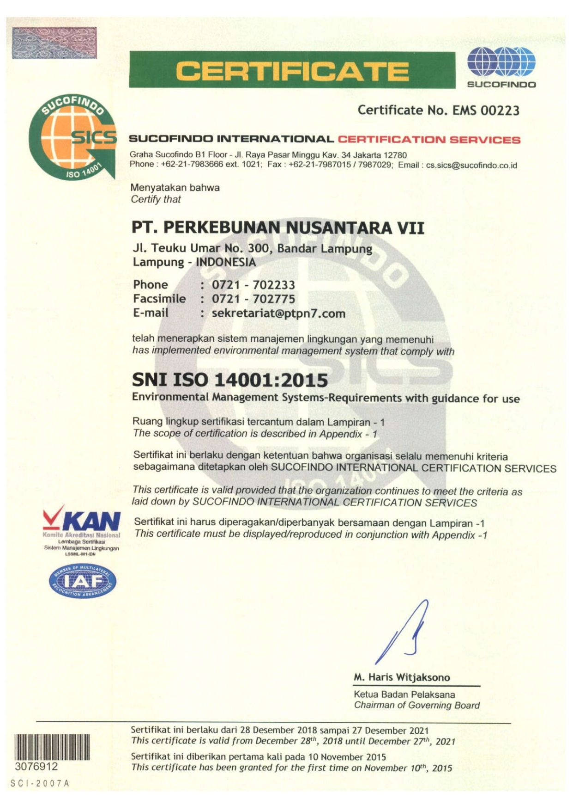
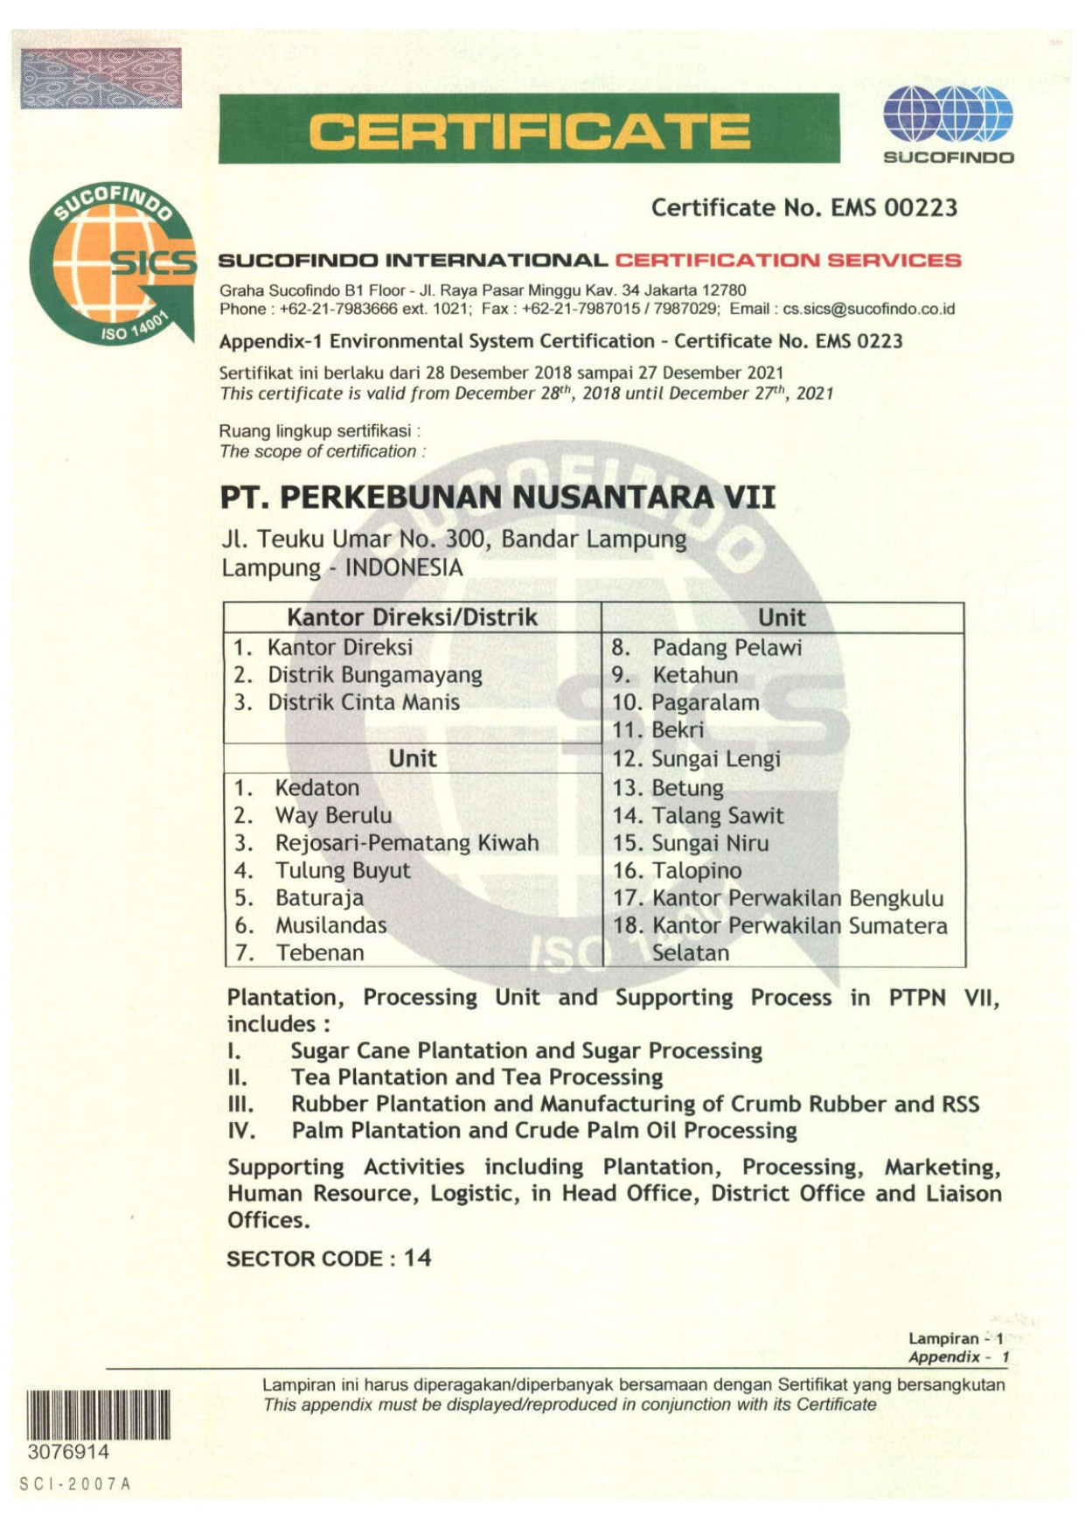
13
TEA CERTIFICATES
OUR TEA CERTIFICATES

Slide 15
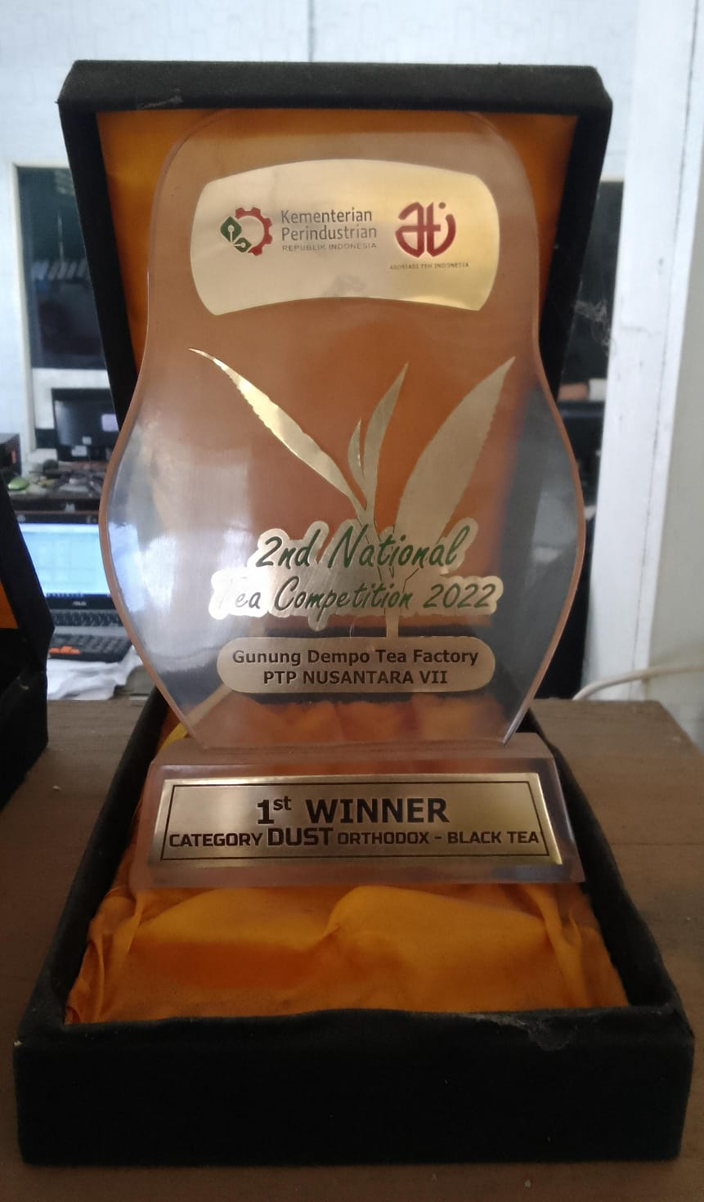
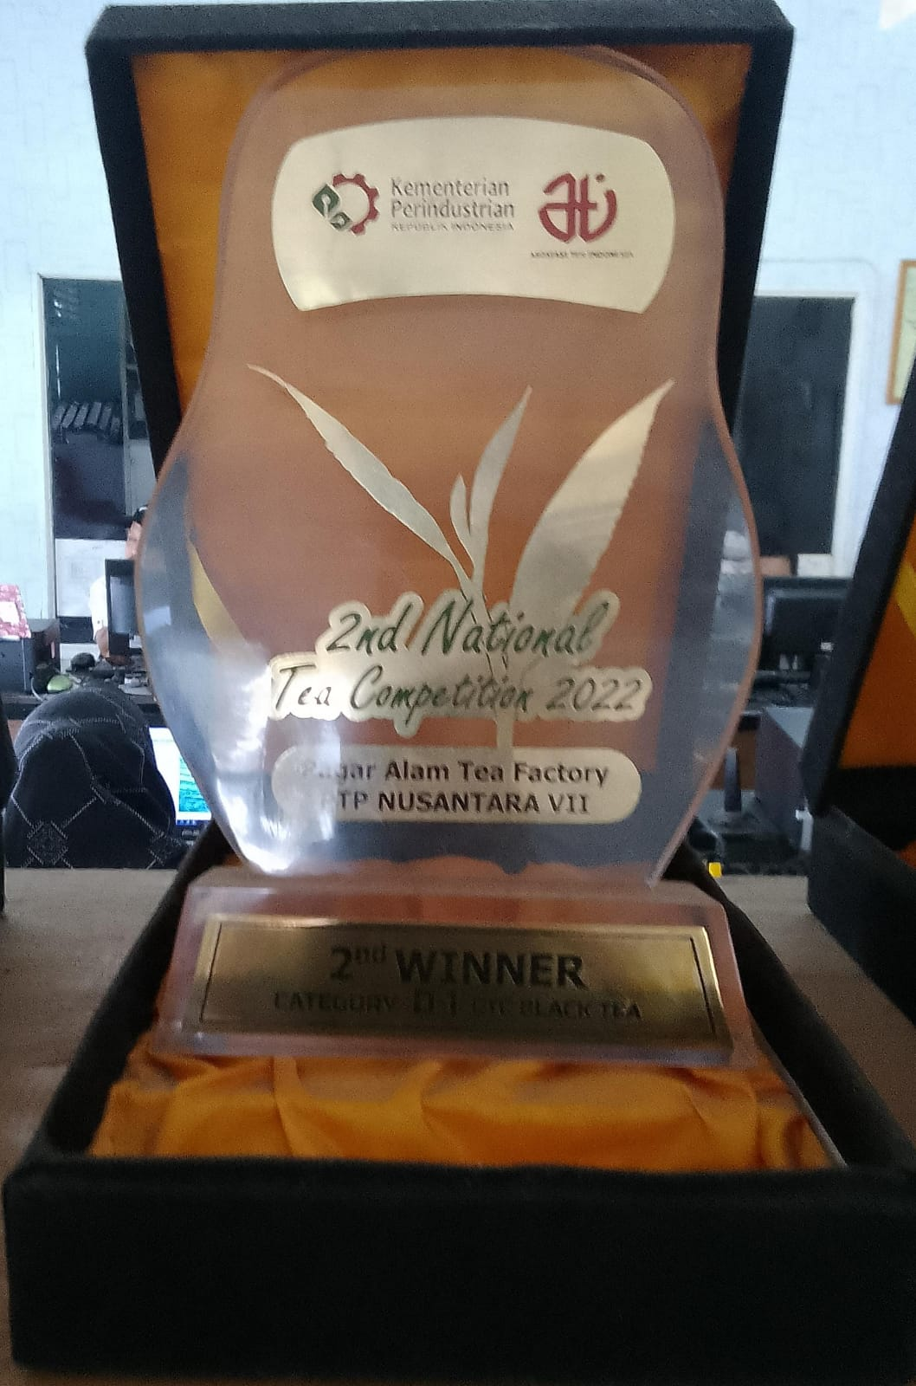
14
TEA CERTIFICATES
TEA AWARDS
1st WINNER Category DUST Orthodox – BLACK TEA on 2nd National Tea Competition 2022
2nd WINNER Category D-1 Orthodox – BLACK TEA on 2nd National Tea Competition 2022

Slide 16

15
Thank You
THANK YOU!

